Slide 1
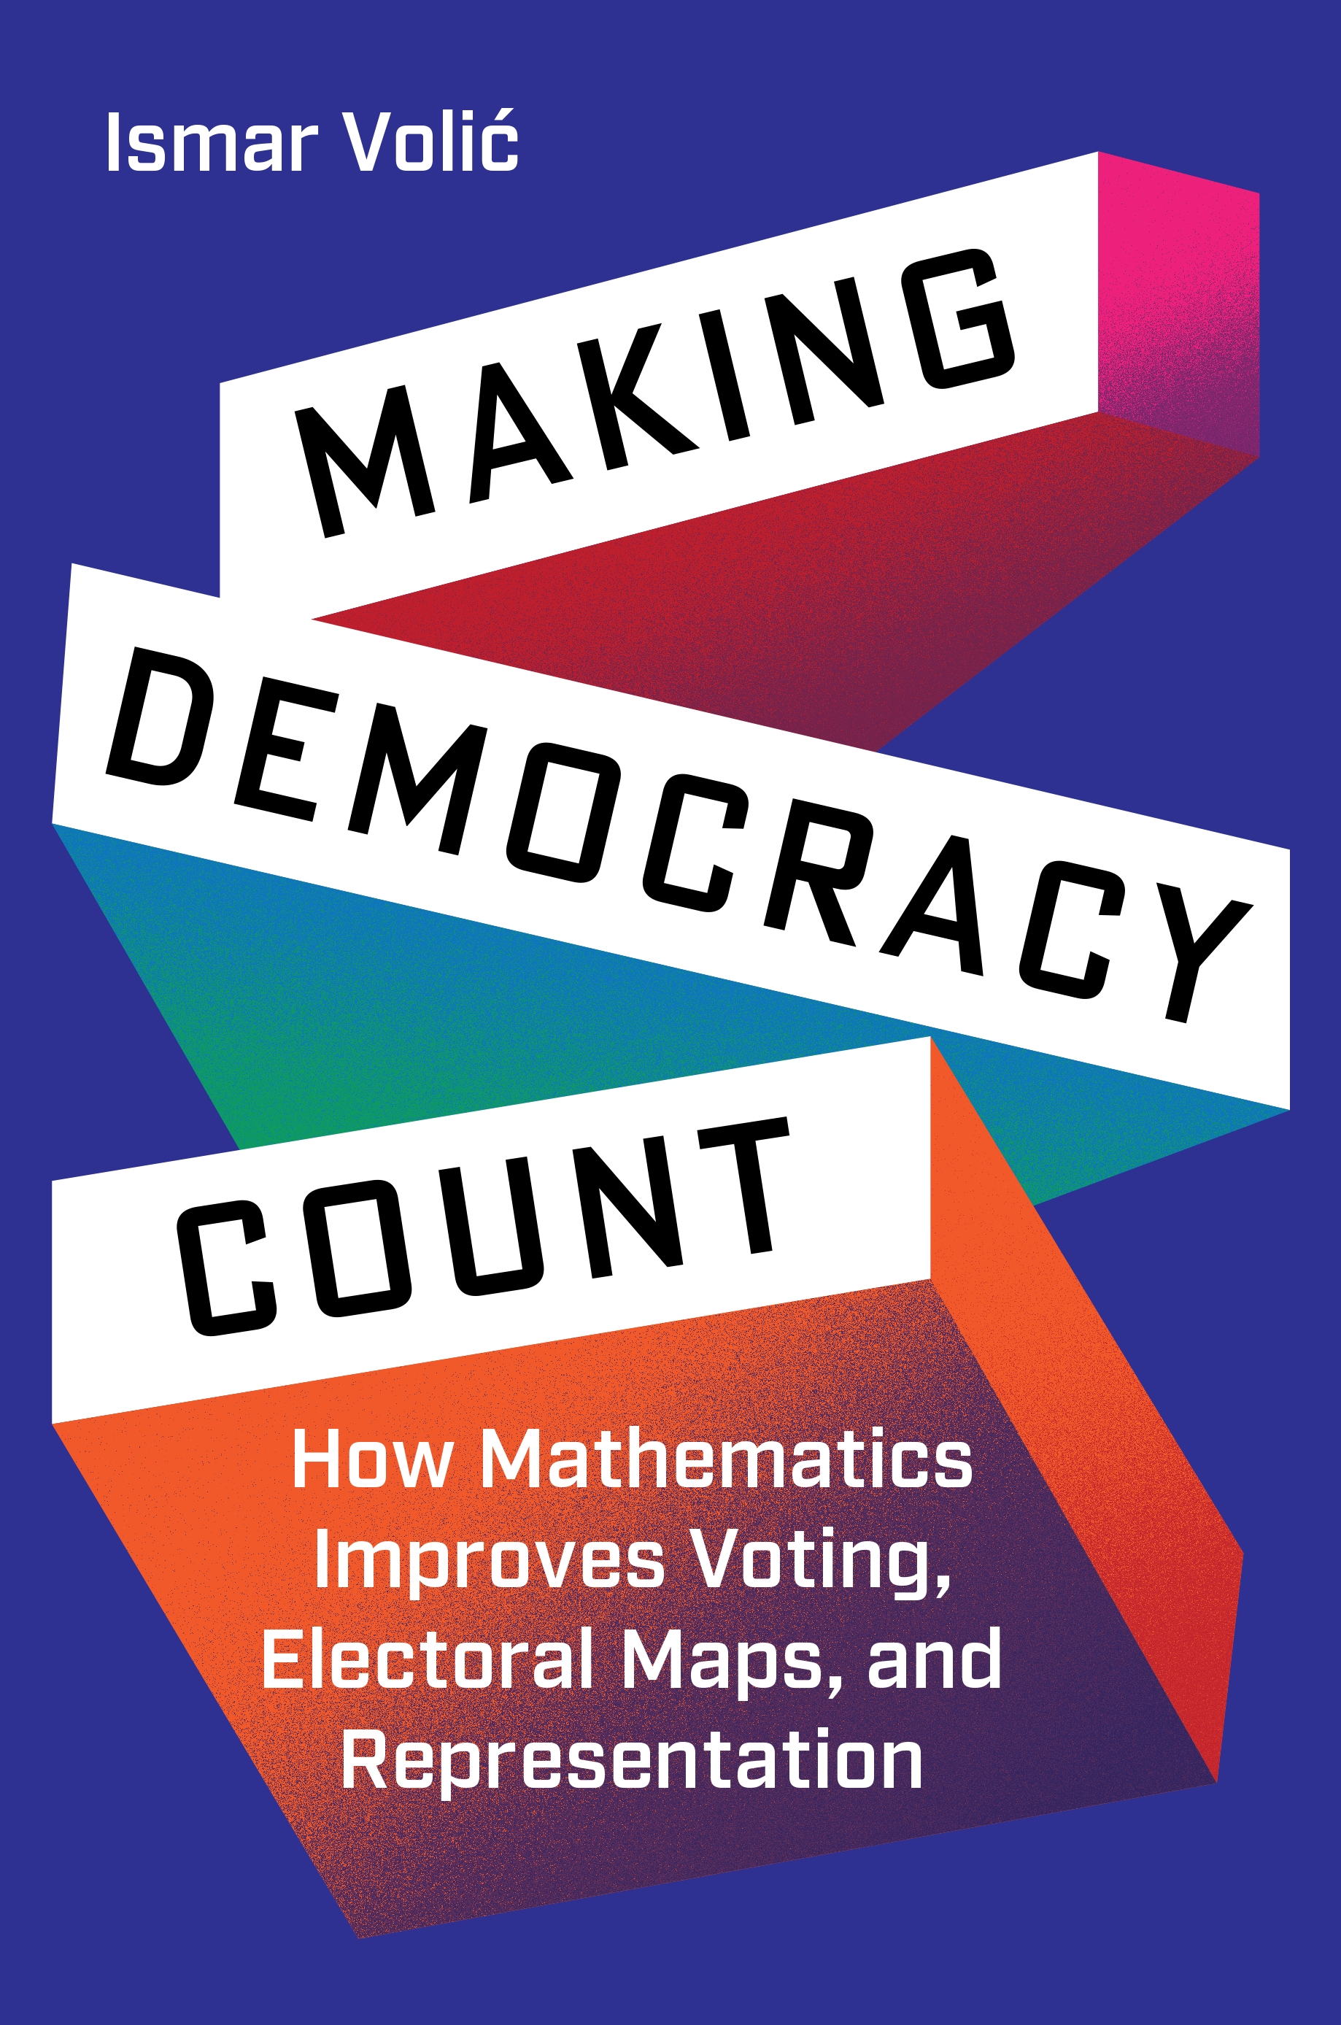
“To Each Their Own”, Making Democracy Count, Ismar Volić (2024)

Slide 2
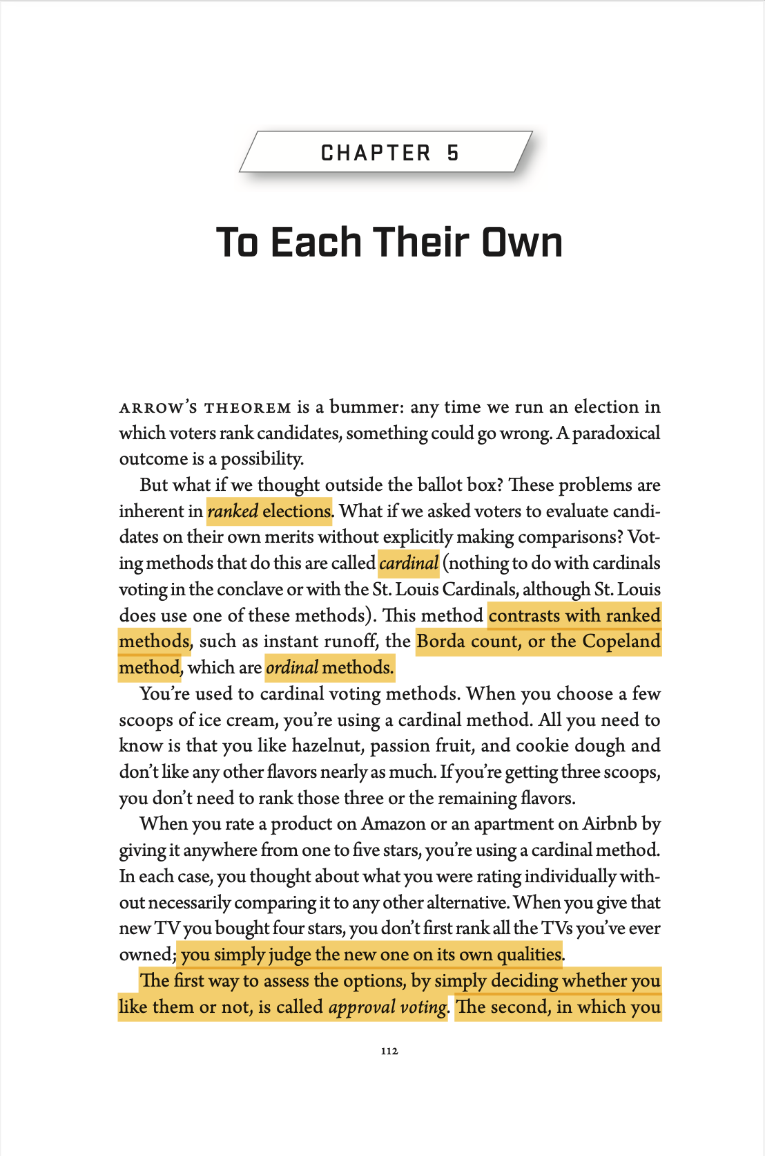
APPROVAL VOTING
RANGE VOTING

Slide 3
APPROVAL VOTING
Definition: Approval voting allows voters to select ("approve of") as many candidates as they like. Each selection counts equally toward the candidate's total score.
Mechanism: Voters review all candidates individually and check a box for each candidate they approve of. The candidate with the highest total approvals wins.

Slide 4
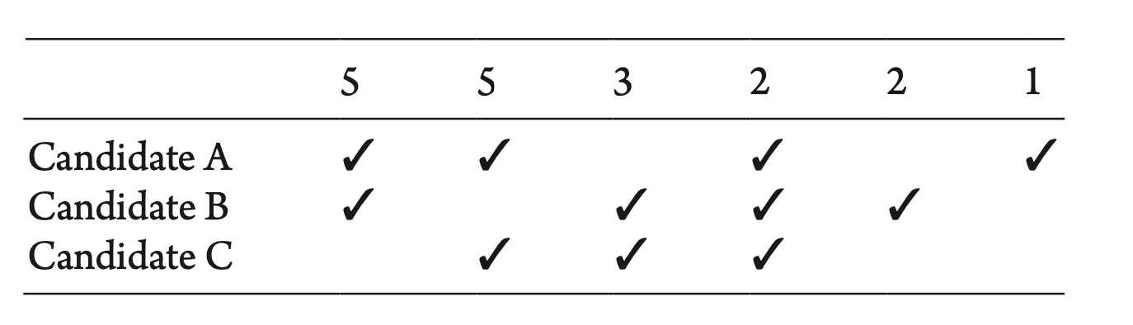
APPROVAL VOTING
Definition: Approval voting allows voters to select ("approve of") as many candidates as they like. Each selection counts equally toward the candidate's total score.
Mechanism: Voters review all candidates individually and check a box for each candidate they approve of. The candidate with the highest total approvals wins.

Slide 5
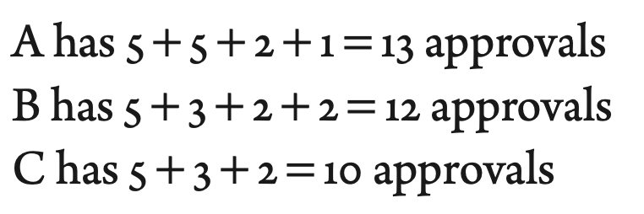
APPROVAL VOTING
Definition: Approval voting allows voters to select ("approve of") as many candidates as they like. Each selection counts equally toward the candidate's total score.
Mechanism: Voters review all candidates individually and check a box for each candidate they approve of. The candidate with the highest total approvals wins.

Slide 6
APPROVAL VOTING
Definition: Approval voting allows voters to select ("approve of") as many candidates as they like. Each selection counts equally toward the candidate's total score.
Mechanism: Voters review all candidates individually and check a box for each candidate they approve of. The candidate with the highest total approvals wins.

Slide 7
APPROVAL VOTING
Definition: Approval voting allows voters to select ("approve of") as many candidates as they like. Each selection counts equally toward the candidate's total score.
Mechanism: Voters review all candidates individually and check a box for each candidate they approve of. The candidate with the highest total approvals wins.
We do this when picking out restaurants, movies, ice cream flavors, etc.

Slide 8

APPROVAL VOTING

Slide 9
APPROVAL VOTING
+ Simple
+ Prevents vote splitting
+ Promotes positive campaigning
+ Encourages honest voting (no “wasted” votes)
+ Benefits both major and minor parties
Notes:
Prevents vote splitting: voters can support multiple candidates simultaneously, ensuring similar candidates do not compete against each other for exclusive votes
Prevents that a schared voter base is splitted
Positive voting: candidates benefit from appealing to a broad range of voters for approvals, discouraging divisive or negative tactics that could alienate potential supporters
No “wasted” votes: voters can approve all candidates they genuinely support without fear of wasting their vote on less popular choice → Smaller parties can benefit from this system

Slide 10
APPROVAL VOTING
+ Simple
+ Prevents vote splitting
+ Promotes positive campaigning
+ Encourages honest voting (no “wasted” votes)
+ Benefits both major and minor parties
Ties are possible
If voter only votes once, same as standard plurality
If voter approves of all, then vote useless
No information on the degree of approval

Slide 11
APPROVAL VOTING
+ Simple
+ Prevents vote splitting
+ Promotes positive campaigning
+ Encourages honest voting (no “wasted” votes)
+ Benefits both major and minor parties
Ties are possible
If voter only votes once, same as standard plurality
If voter approves of all, then vote useless
No information on the degree of approval
Complies with anonymity, neutrality, monotonicity, and IIA, as not a ranked voting system
Notes:
Anonymity: treats all voters equally because the outcome depends only on the total number of approvals, not on who casts the votes
Neutrality: treats all candidates equally, as the rules for tallying approvals apply uniformly without favoring any candidate
Monotonicity: ensures that approving an additional candidate never harms their chances of winning or affects the standings of other candidates negatively.
IIA: Unlike other voting systems (e.g., ranked voting), approval voting does not involve preferences or rankings that can be distorted by the presence of an irrelevant candidate. The decision to approve or disapprove each candidate is isolated, so the relationship between two candidates is unaffected by a third.

Slide 12
APPROVAL VOTING: IN ACTION
Works well in…

Slide 13

APPROVAL VOTING: IN ACTION
Works well in…
Not opposed to anyone being elected…

Slide 14

APPROVAL VOTING: IN ACTION
Works well in…
Not opposed to anyone being elected…
No limit of candidates to be elected…

Slide 15
APPROVAL VOTING: IN ACTION
Where it can go wrong…

Slide 16
APPROVAL VOTING: IN ACTION
Where it can go wrong…
Suppose 10 voters participate
9 approve Candidates A and B; they like A more but think B is ok too.
1 approves only Candidate B.

Slide 17
APPROVAL VOTING: IN ACTION
Where it can go wrong…
Suppose 10 voters participate
9 approve Candidates A and B; they like A more but think B is ok too.
1 approves only Candidate B.
Results:
A = 9 approvals
B = 10 approvals

Slide 18
APPROVAL VOTING: IN ACTION
Where it can go wrong…
Suppose 10 voters participate
9 approve Candidates A and B; they like A more but think B is ok too.
1 approves only Candidate B.
Results:
A = 9 approvals
B = 10 approvals
Winner: Candidate B, even though 90% of voters preferred A over B​

Slide 19
APPROVAL VOTING: IN ACTION
Where it can go wrong…
Suppose 10 voters participate
9 approve Candidates A and B; they like A more but think B is ok too.
1 approves only Candidate B.
Results:
A = 9 approvals
B = 10 approvals
Winner: Candidate B, even though 90% of voters preferred A over B​

Slide 20
APPROVAL VOTING
RANGE VOTING

Slide 21
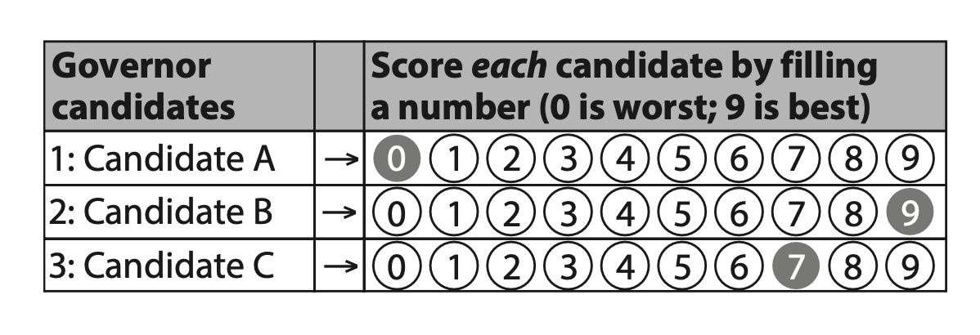
RANGE VOTING

Slide 22
RANGE VOTING

Slide 23
RANGE VOTING
The range is mathematically unimportant; the main consideration is the voter’s psychology

Slide 24

RANGE VOTING: IN ACTION

Slide 25

RANGE VOTING: IN ACTION

Slide 26
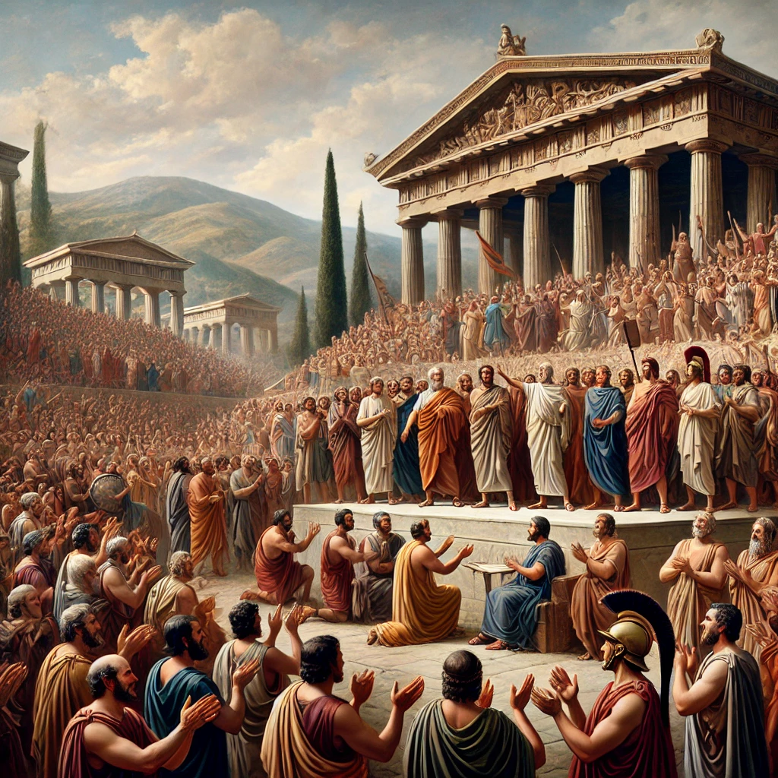
RANGE VOTING: IN ACTION

Slide 27
RANGE VOTING: IN ACTION
Hold up: where it’s not so good…

Slide 28
RANGE VOTING: IN ACTION
Hold up: where it’s not so good…
The scores can mean different things to different people
Computing an average

Slide 29
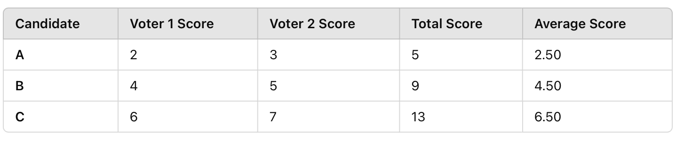
RANGE VOTING: IN ACTION
Hold up: where it’s not so good…
The scores can mean different things to different people
Computing an average

Slide 30
RANGE VOTING: IN ACTION
Hold up: where it’s not so good…
The scores can mean different things to different people
Computing an average

Slide 31
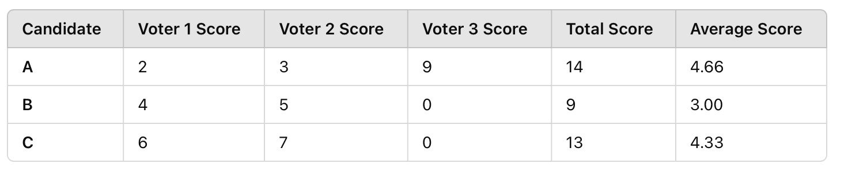
RANGE VOTING: IN ACTION
Hold up: where it’s not so good…
The scores can mean different things to different people
Computing an average

Slide 32
RANGE VOTING: IN ACTION
Hold up: where it’s not so good…
The scores can mean different things to different people
Computing an average

Slide 33
RANGE VOTING: IN ACTION
Hold up: where it’s not so good…
The scores can mean different things to different people
Computing an average
Strategic / tactical voting (!)

Slide 34
RANGE VOTING: IN ACTION
Hold up: where it’s not so good…
The scores can mean different things to different people
Computing an average → mitigated by systems that use the median instead

Slide 35
APPROVAL VOTING
RANGE VOTING

Slide 36
APPROVAL VOTING
RANGE VOTING

Slide 37
Thank you for your attention!
Any questions?

